Slide 1


Jagruti.C
3/9/2025

Slide 2

Outline
Executive Summary
Introduction
Methodology
Results
Conclusion
Appendix

Slide 3
Executive Summary
Summary of methodologies:
- Data collection
- Data wrangling
- Exploratory Data Analysis with Data Visualization
- Machine Learning Prediction
Summary of all results:
- Exploratory Data Analysis results
- Interactive analytics demo in screenshorts
- Predictive analysis results

Slide 4
Introduction
In this capstone, we will predict if the Falcon 9 first stage will land successfully. Space x advertises Falcone 9 rocket launches on it's website with a cost of 62 million dollars; other providers cost upward 165 million dollars each, much of the saving is because SpaceX can reuse the first stage. Therefore if we can determine if the first stage will land. We can determine the cost of a launch. This information can be used if an alternate company wants to bid against SpaceX for a rocket launch.
Most unsuccessful landing are planned .Something ,SpaceX will perform a controlled landing in the ocean.
The main question that we are trying to answer is , for a given set of features about a Falcon 9 rocket launch which include its payload mass, orbit type, launch site, and so on will first stage of the rocket land successfully?

Slide 5

Section 1

Slide 6
Methodology
Executive Summary
Data collection methodology:
Data collection ,wrangling and formatting ,using:
SpaceX API
Web scraping
Perform data wrangling
Using the .Fillan() method to remove Nan values
Using the . Value counts() method the following :
demine Number of launches on each site
Number and occurrence of each orbit
Number of occurrence of mission outcomes per orbits type
Perform exploratory data analysis (EDA) using visualization and SQL
Using SQL queries to manipulate and evaluate the SpaceX dataset
Using Pandas and matplotlib to visualize .
Perform interactive visual analytics using Folium and Plotly Dash
Perform predictive analysis using classification models

Slide 7
Data Collection
The data sets are collected using 2 method :
1)Request to space x API
- Gathered space’x past launch data vis open-source API.
- Retrieved and processed this data with GET request’.
- ensured the data included only Falcon 9 launches.
- Filled in missing payload weights from secret mission with average values.
2) web Scraping
- Requested past Falcon 9 and Falcon Heavy launch data from Wikipedia’s relevant page.
- Accessed the Falcon 9 launch page via its direct Wikipedia link.
- Extracted all the column names from the HTML table.
- parsed and transformed the table into a pandas data frame suitable for analysis.

Slide 8
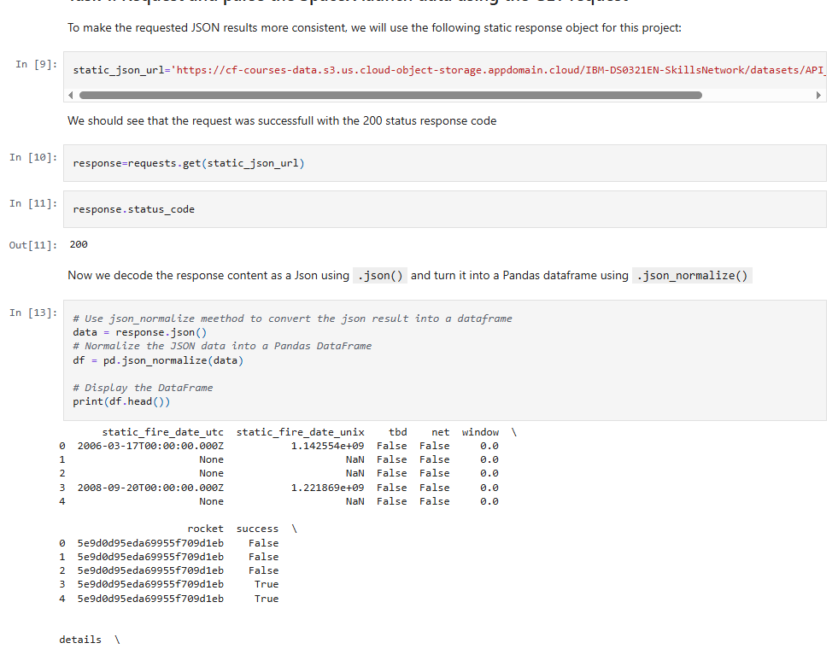
Data Collection – SpaceX API
Data collection with SpaceX REST call
https://github.com/DaJagu/IBM-Applied-Data-Science-Capstone/blob/main/Data%20Collection%20API%20Lab.ipynb
Place your flowchart of SpaceX API calls here

Slide 9
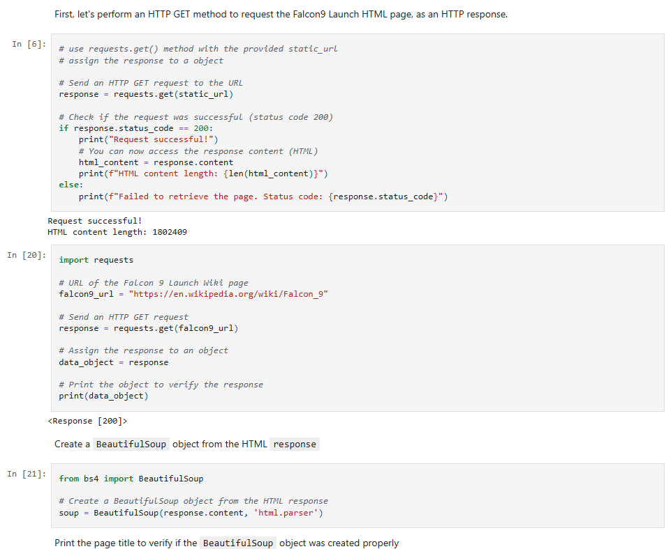
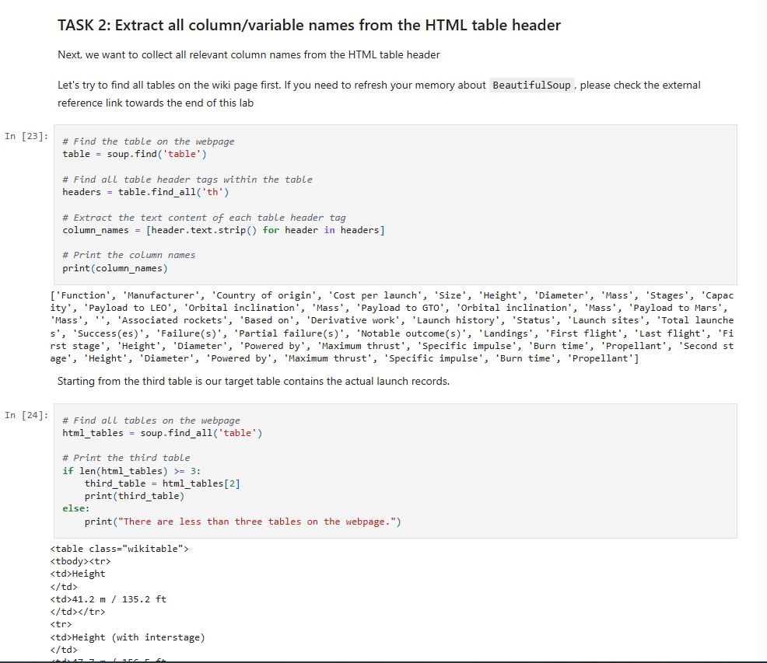
Data Collection - Scraping
Data Scrapping from wikipedia
https://github.com/DaJagu/IBM-Applied-Data-Science-Capstone/blob/main/Web%20Scraping%20lab.ipynb
Place your flowchart of web scraping here

Slide 10
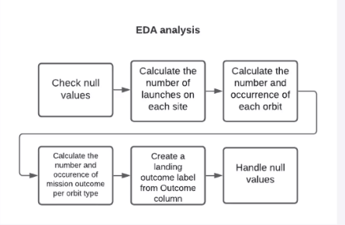
Data Wrangling
https://github.com/DaJagu/IBM-Applied-Data-Science-Capstone/blob/main/Web%20Scraping%20lab.ipynb

Slide 11
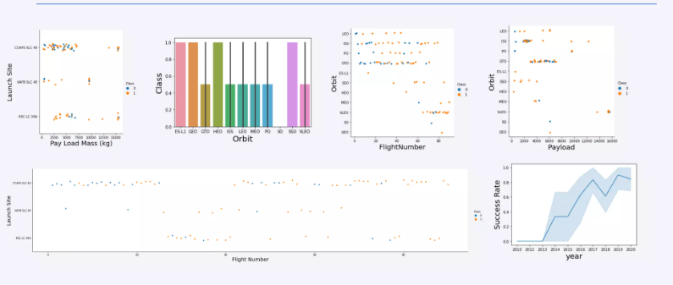
EDA with Data Visualization
https://github.com/DaJagu/IBM-Applied-Data-Science-Capstone/blob/main/Web%20Scraping%20lab.ipynb

Slide 12
EDA with SQL
SQL queries performed include:
- Displaying the names of the unique launch sites in the space mission
- Displaying 5 records where launch sited begin with the string “KSC”
- Displaying toral payload mass carried by booster launch by NASA(CRS)
- Listing the data where the successful landing outcome in drone ship was achieved
- Displaying Average payload mass carried by booster version F9v1.1
- listing the total number of successful and failure mission outcomes
- Versions launch _site for the months in year 2017
- Ranking the count of successful landing outcomes between the data 2010 06 04 and 2017 0320 descending.
https://github.com/DaJagu/IBM-Applied-Data-Science-Capstone/blob/main/jupyter-labs-eda-sql-coursera_sqllite.ipynb

Slide 13
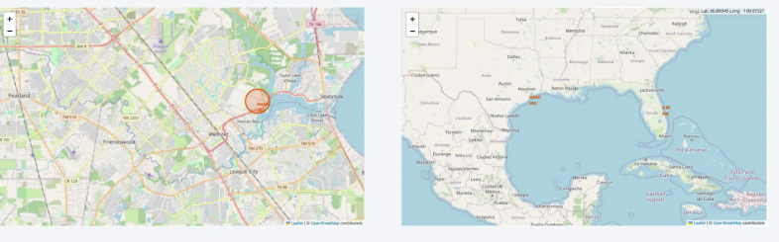
Build an Interactive Map with Folium
https://github.com/DaJagu/IBM-Applied-Data-Science-Capstone/blob/main/lab_jupyter_launch_site_location.ipynb

Slide 14
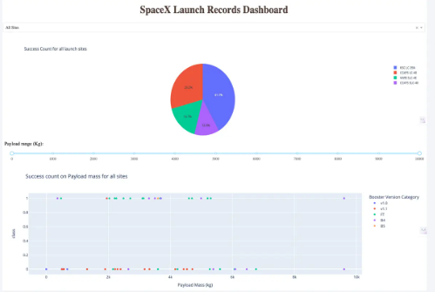
Build a Dashboard with Plotly Dash

Slide 15
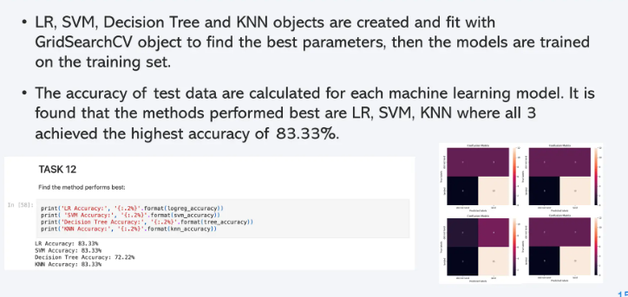
Predictive Analysis (Classification)

Slide 16
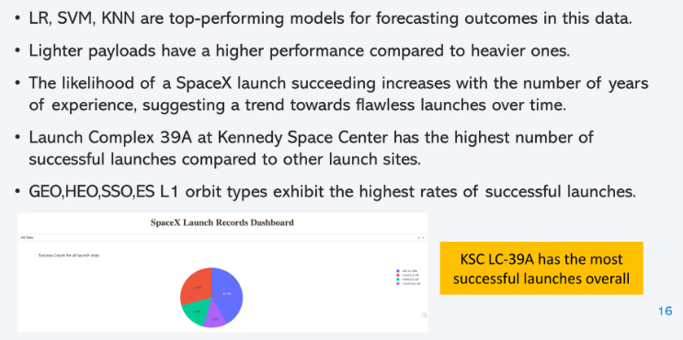
Results

Slide 17

Section 2

Slide 18
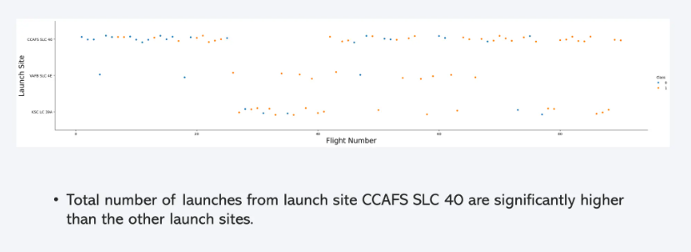
Flight Number vs. Launch Site

Slide 19
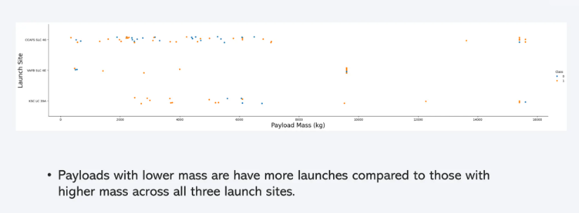
Payload vs. Launch Site

Slide 20
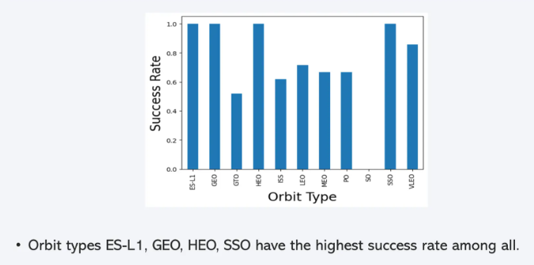
Success Rate vs. Orbit Type

Slide 21
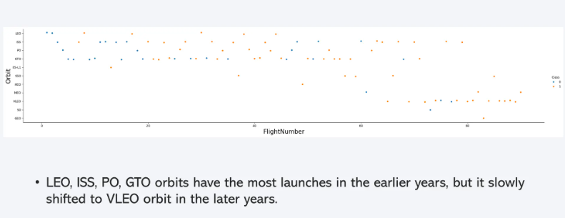
Flight Number vs. Orbit Type

Slide 22
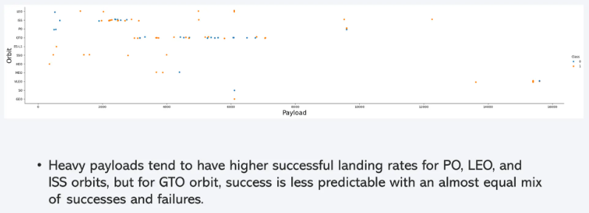
Payload vs. Orbit Type

Slide 23
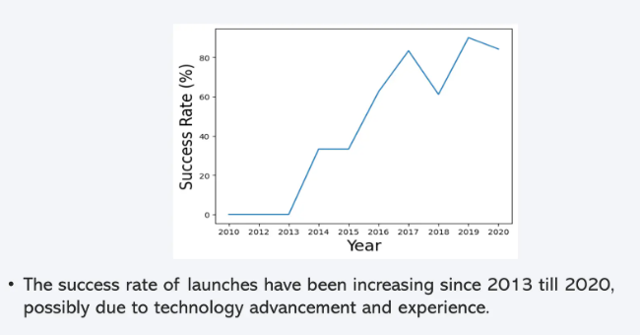
Launch Success Yearly Trend

Slide 24
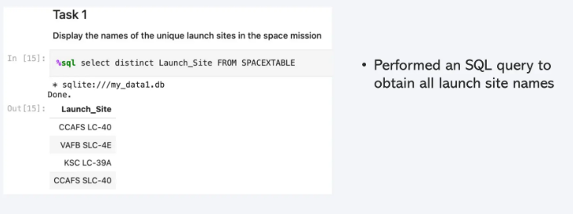
All Launch Site Names

Slide 25
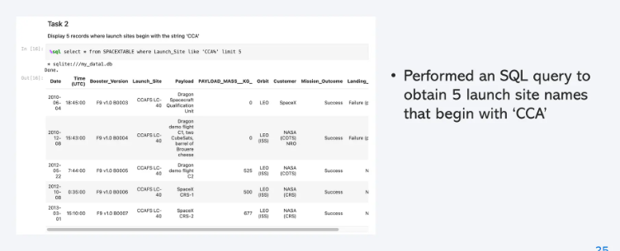
Launch Site Names Begin with 'CCA'

Slide 26
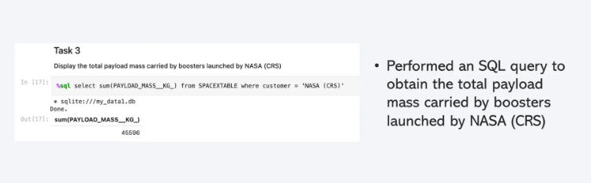
Total Payload Mass

Slide 27
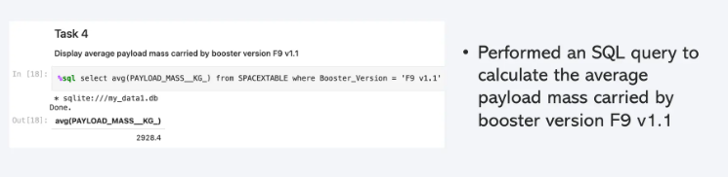
Average Payload Mass by F9 v1.1

Slide 28
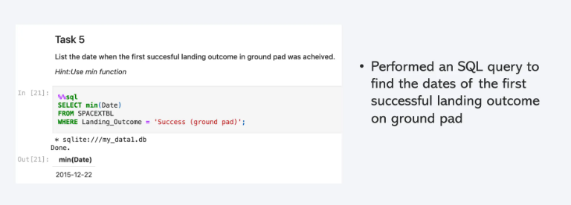
First Successful Ground Landing Date

Slide 29
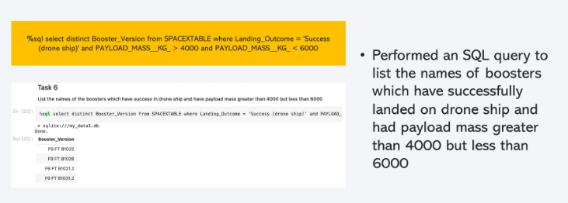
Successful Drone Ship Landing with Payload between 4000 and 6000

Slide 30
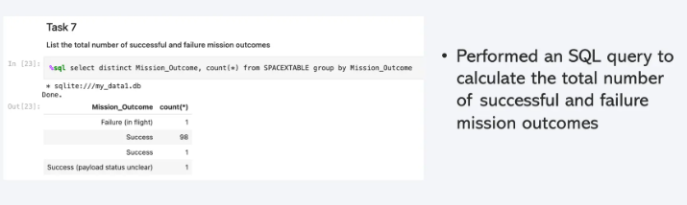
Total Number of Successful and Failure Mission Outcomes

Slide 31
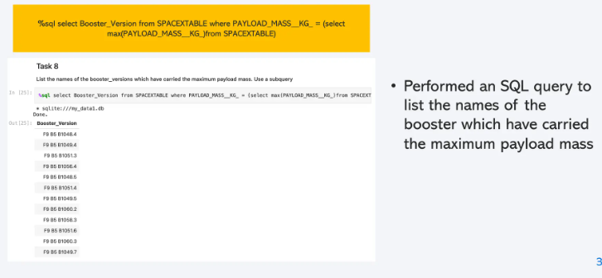
Boosters Carried Maximum Payload

Slide 32
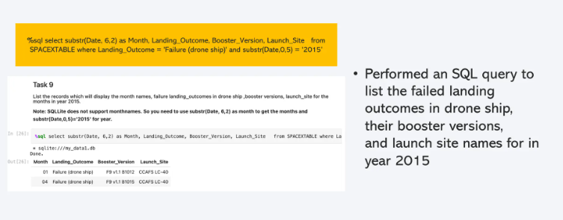
2015 Launch Records

Slide 33
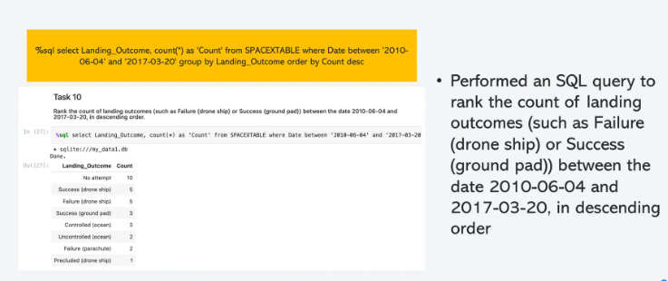
Rank Landing Outcomes Between 2010-06-04 and 2017-03-20

Slide 34

Section 3

Slide 35
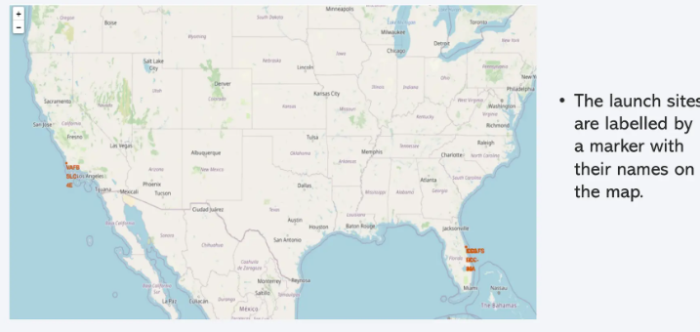
<Folium Map Screenshot 1>

Slide 36
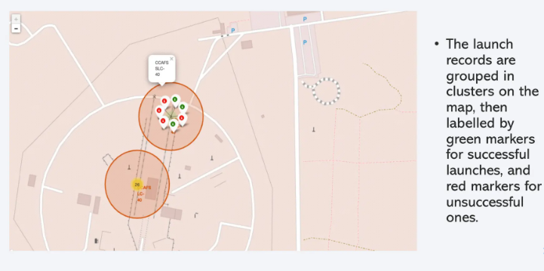
<Folium Map Screenshot 2>

Slide 37
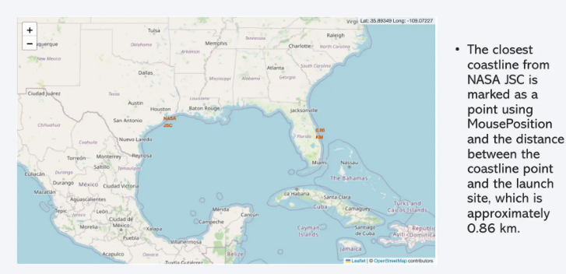
<Folium Map Screenshot 3>

Slide 38

Section 4

Slide 39
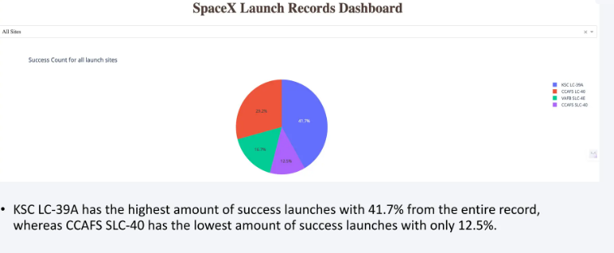
<Dashboard Screenshot 1>

Slide 40
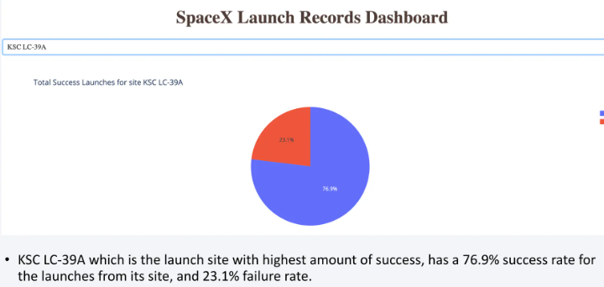
<Dashboard Screenshot 2>

Slide 41
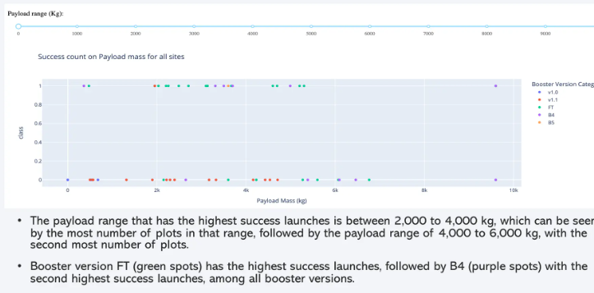
<Dashboard Screenshot 3>

Slide 42

Section 5

Slide 43
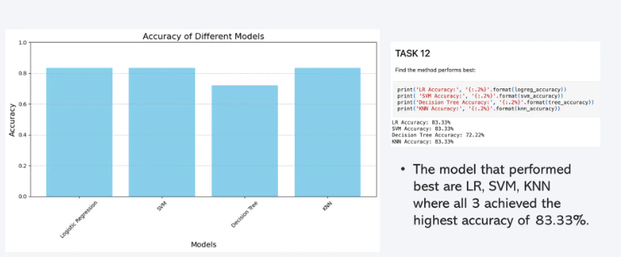
Classification Accuracy

Slide 44
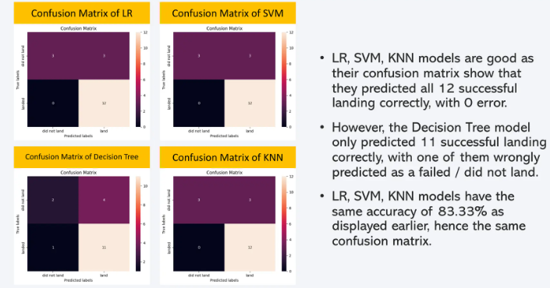
Confusion Matrix

Slide 45
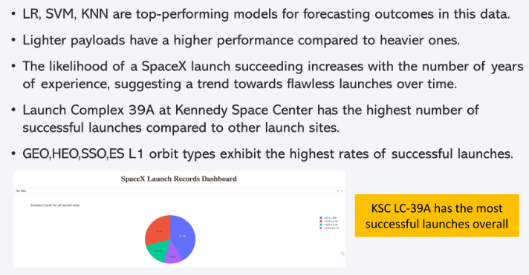
Conclusions

Slide 46
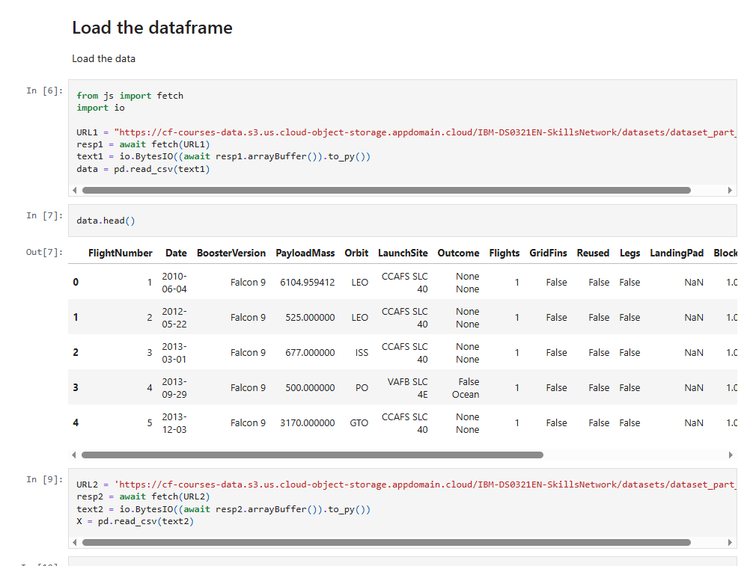
Appendix

Slide 47


